Slide 1
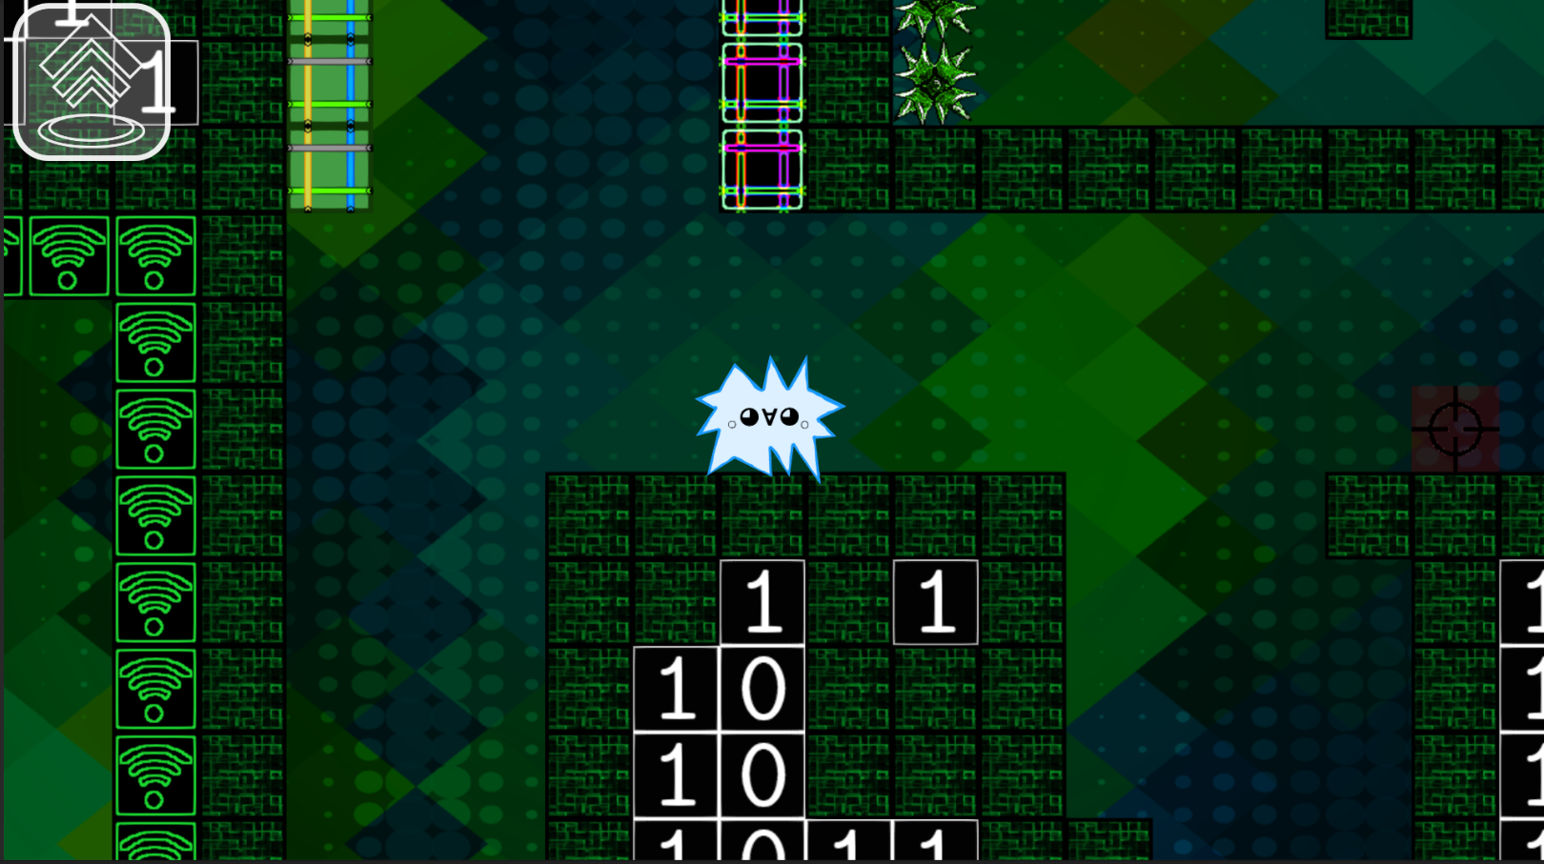

Character Name
There is the area to show the information to player, write down hints or something else.
Or hurt players

Slide 3

There is the area to show the information to player, write down hints or something else.
Or hurt players
Programmer

Slide 4
There is the area to show the information to player, write down hints or something else.
Or hurt players
Programmer

Slide 7
Character Name
There is the area to show the information to player, write down hints or something else.
Or hurt players

Slide 8
Character Name
There is the area to show the information to player, write down hints or something else.
Or hurt players

Slide 9
There is the area to show the information to player, write down hints or something else.
Or hurt players
Tried: 8times
Time: 3:30

